Slide 1


Slide 2




Slide 3
Overview
Types of Tanks
Pumps
Meters
Pulsers
Hanging Hardware
Tank Components
Additional Application Equipment
DEF Equipment
Oil / Lube Equipment
Services Offered
Safety / Environmental
Fuel Additives
Troubleshooting
Contact Information

Slide 4
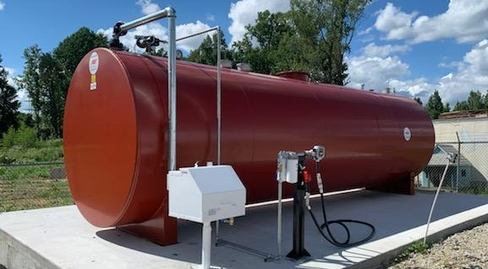
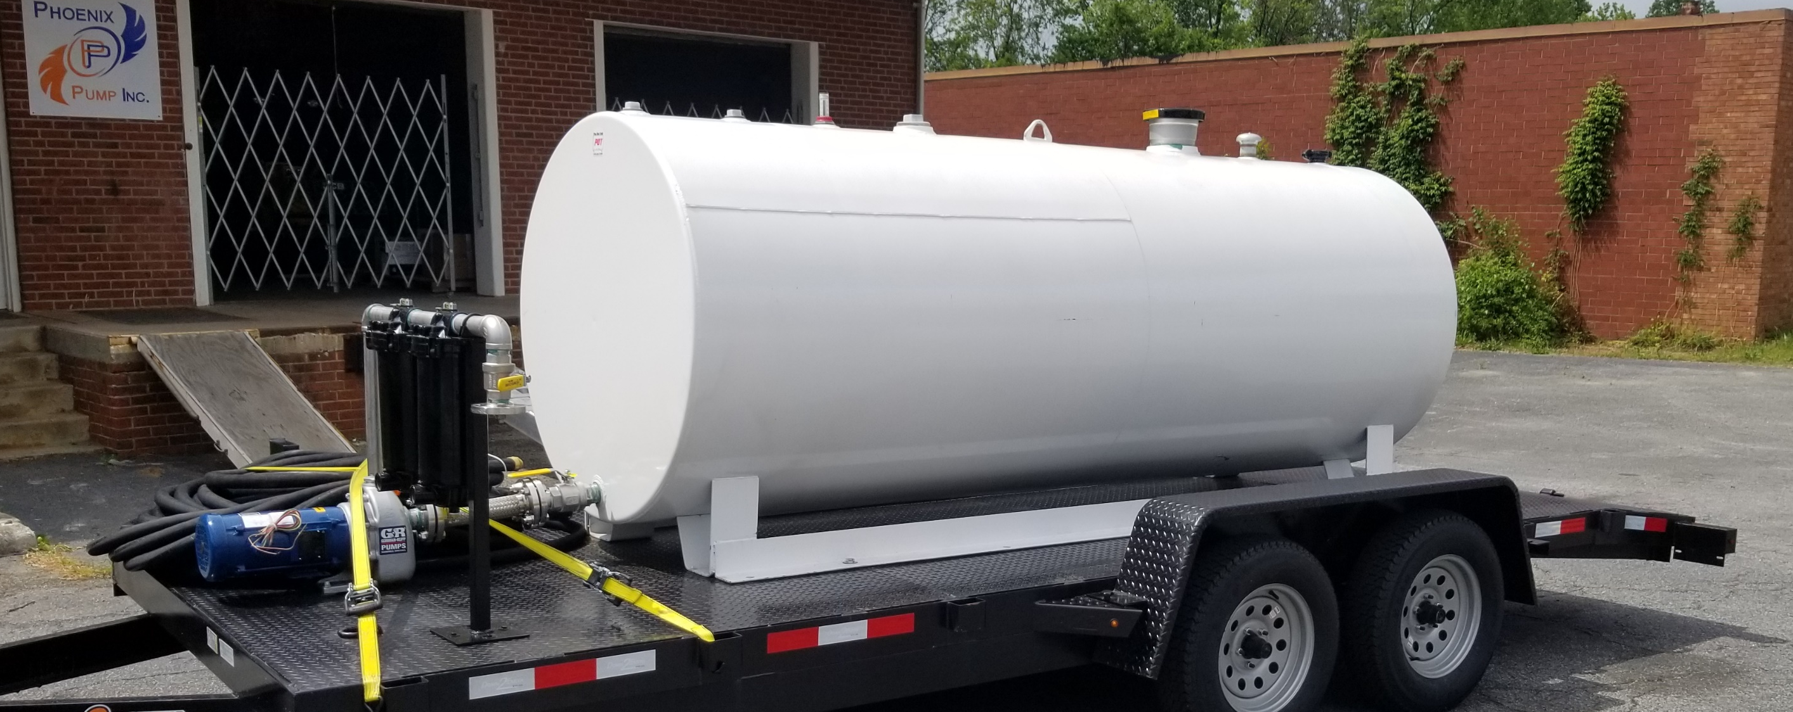
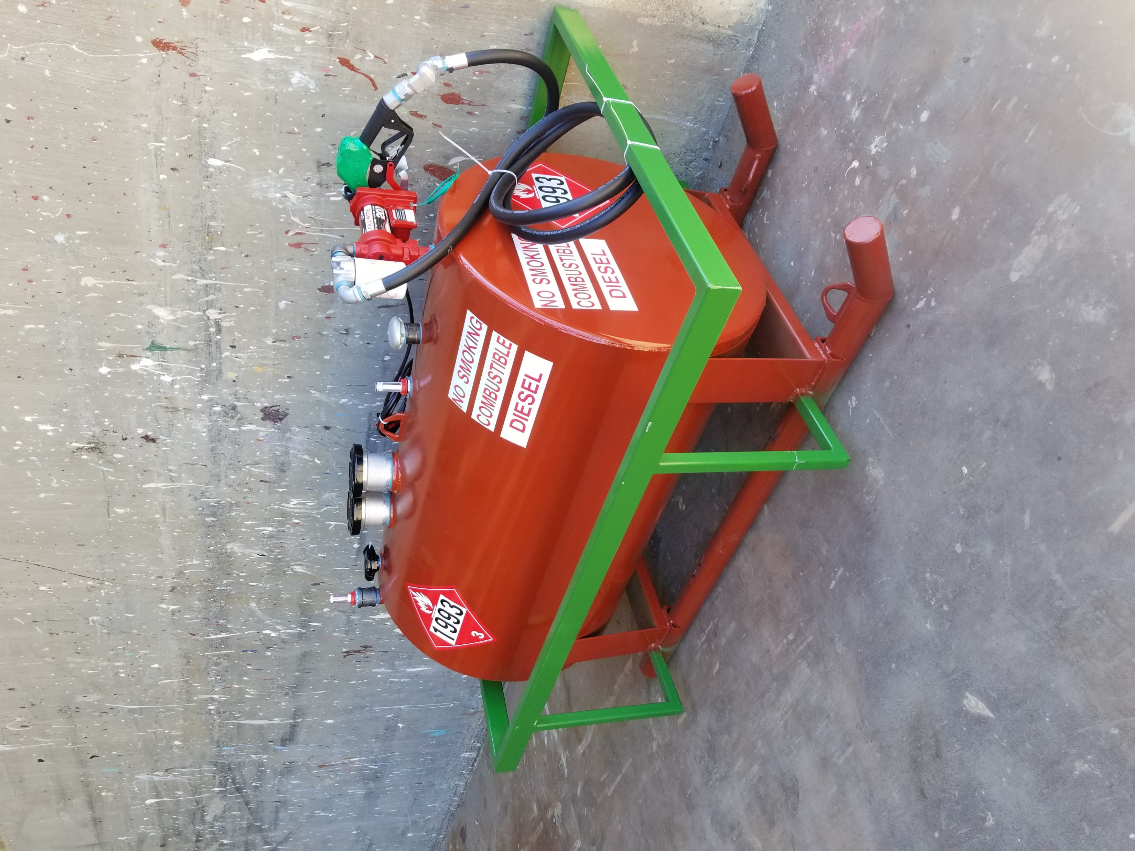
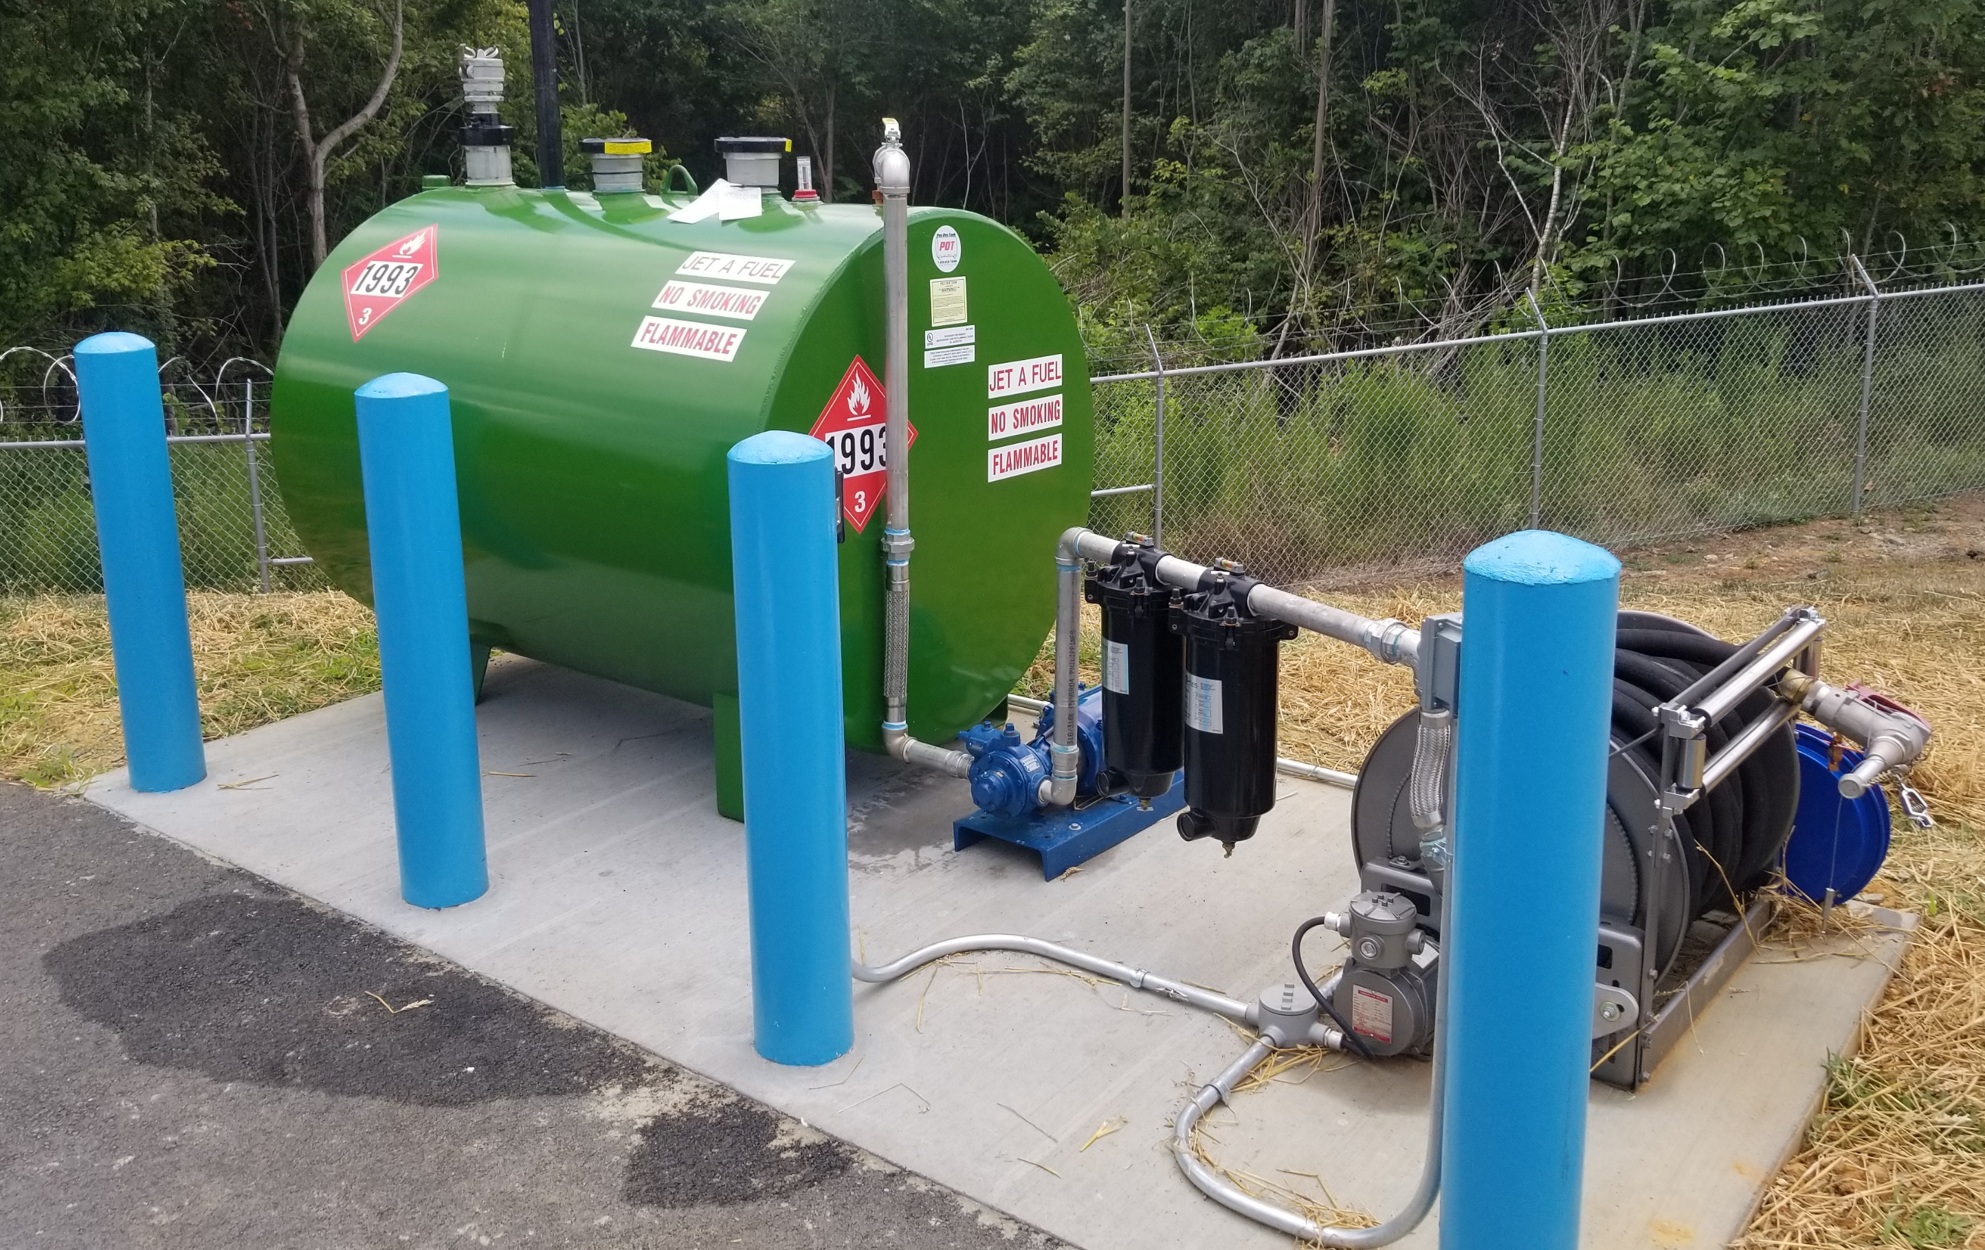
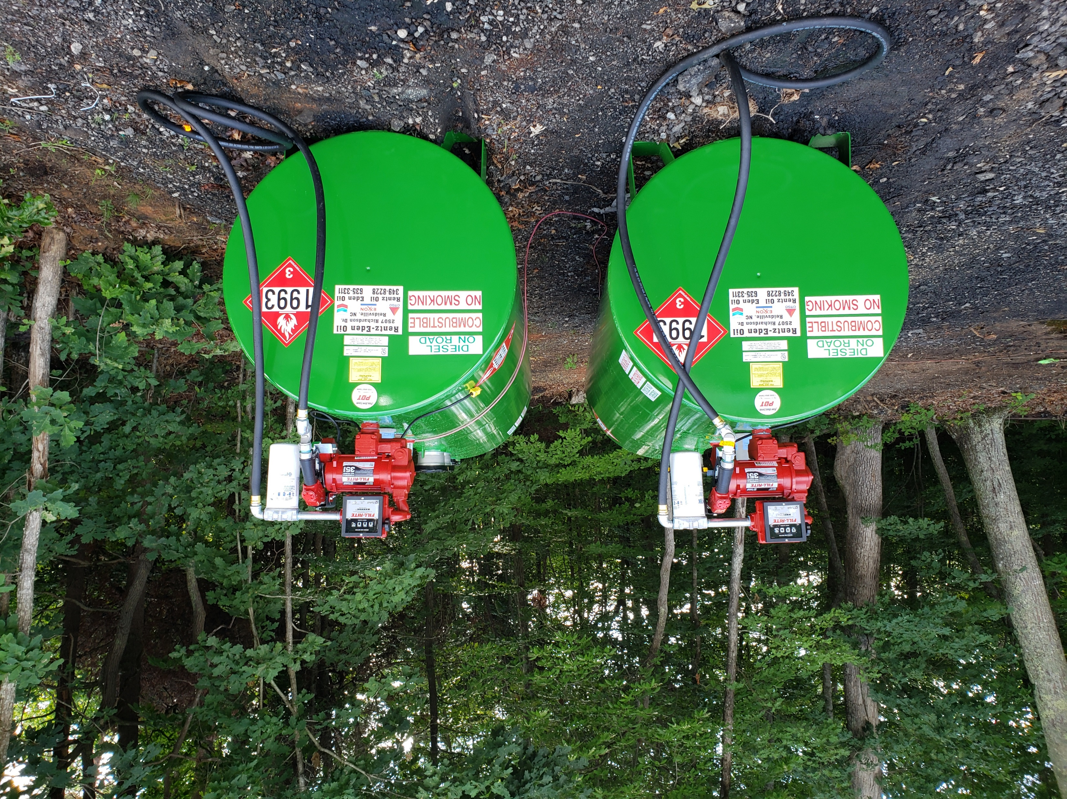
Round Above Ground Storage Tanks
(Horizontal)

Slide 5
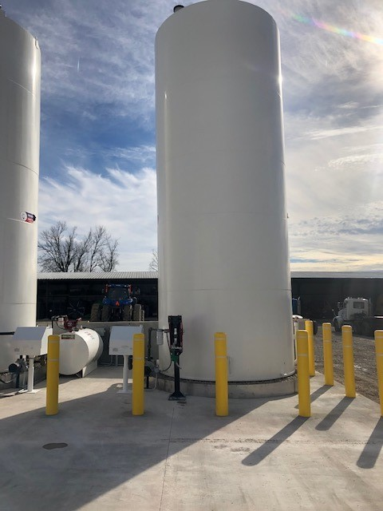
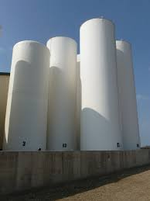
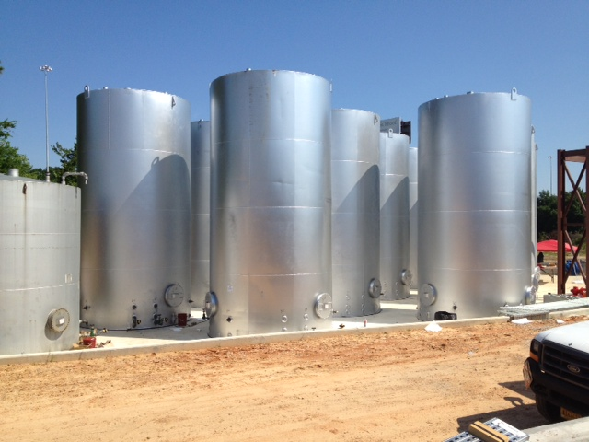
Round Above Ground Storage Tanks
(Vertical)

Slide 6
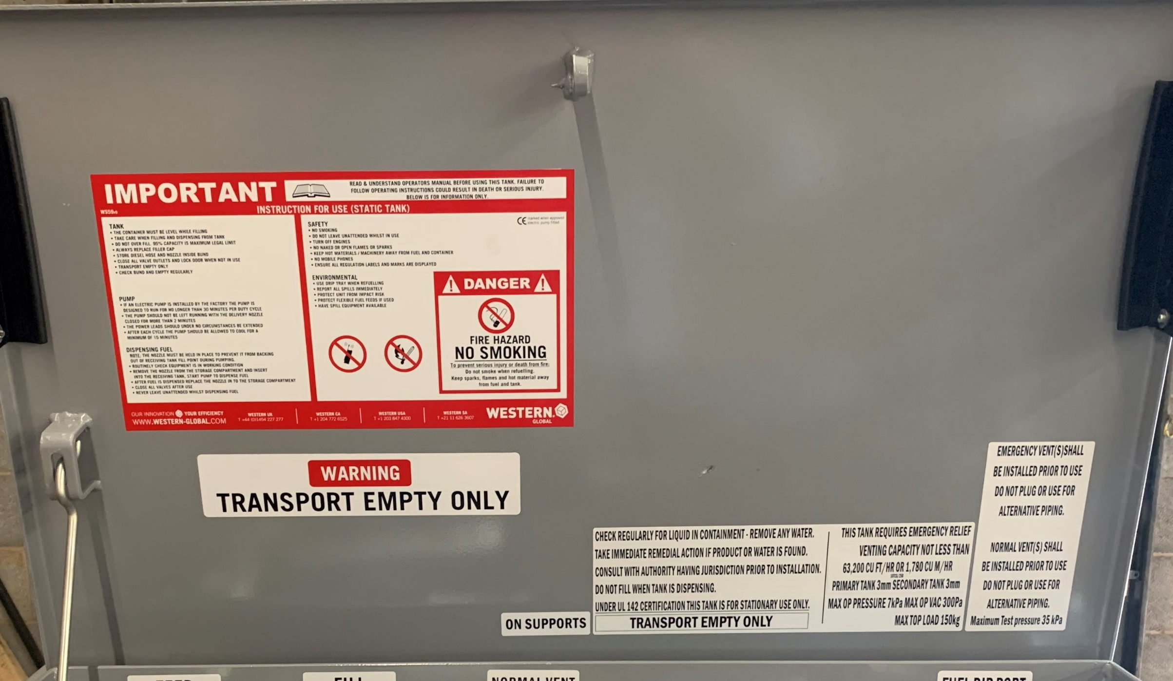
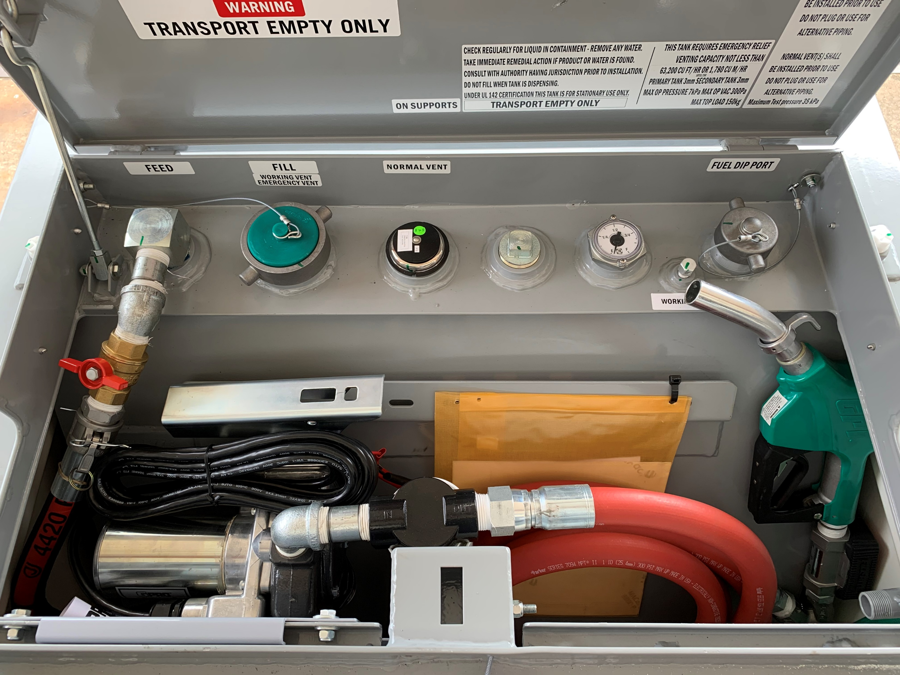
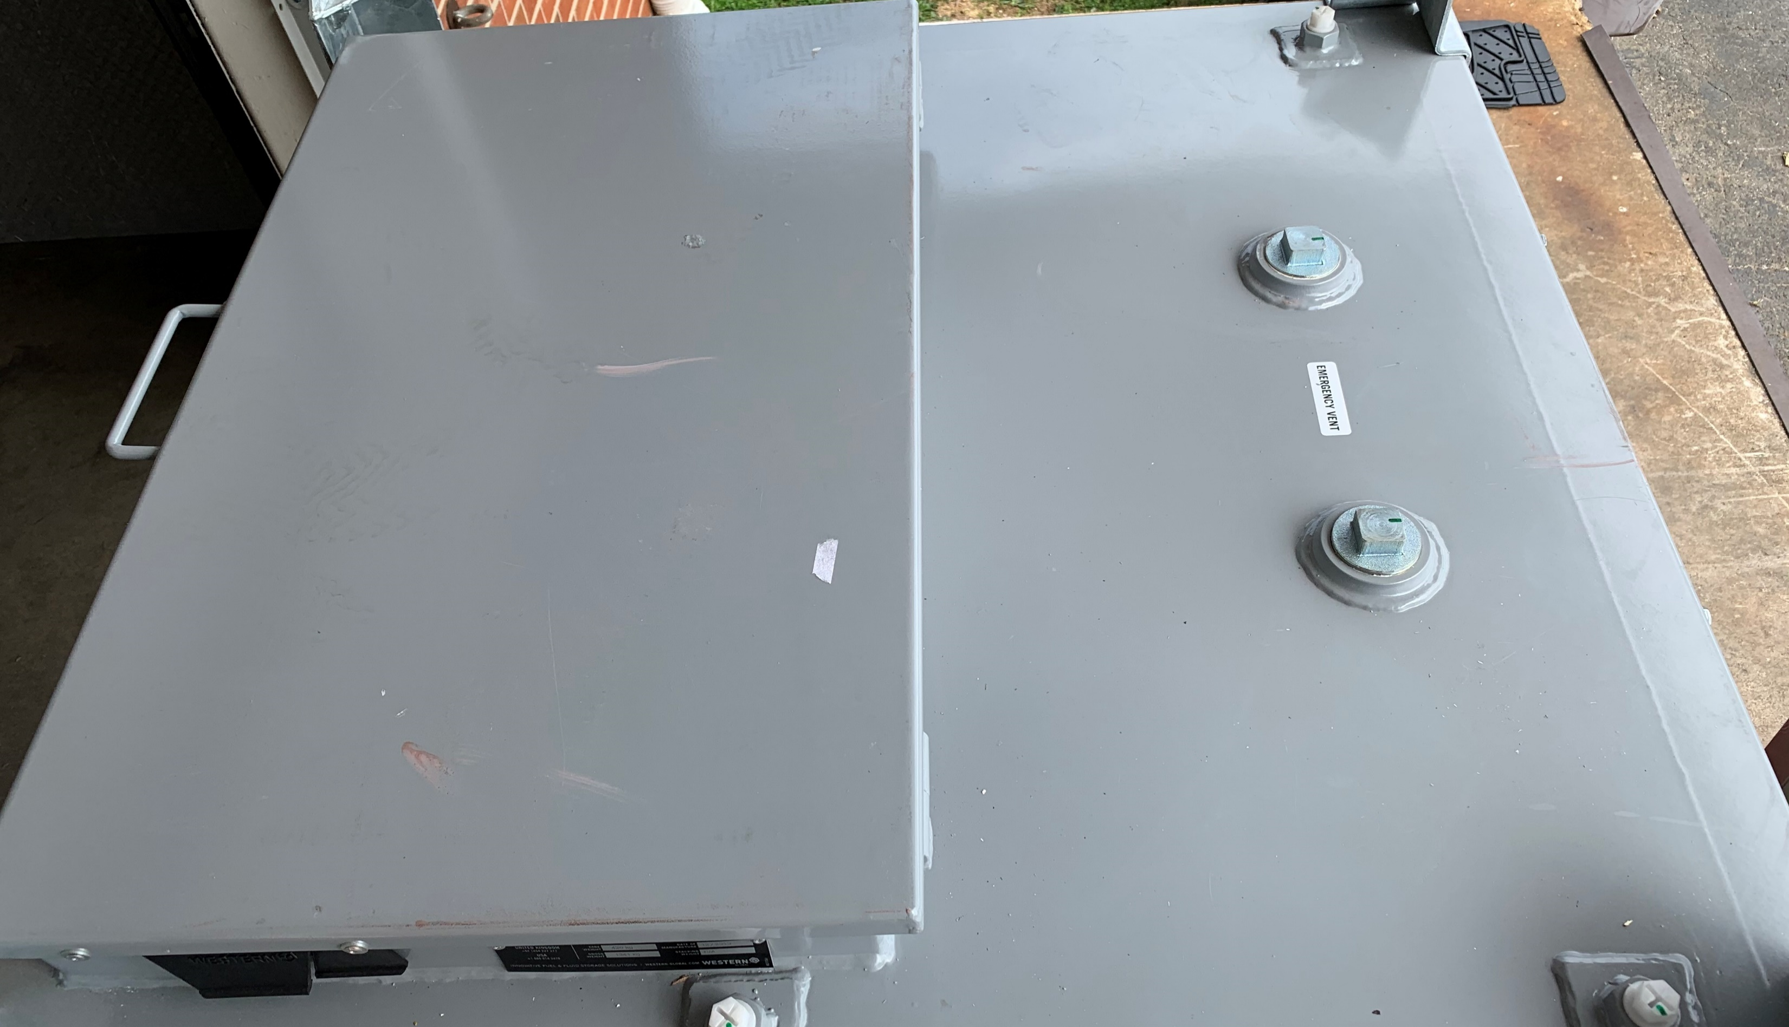
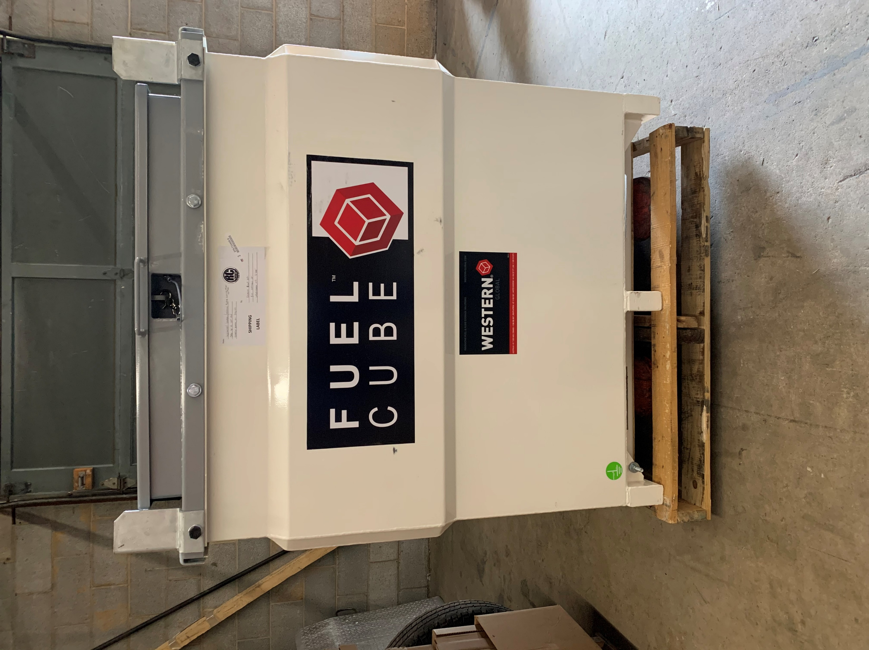
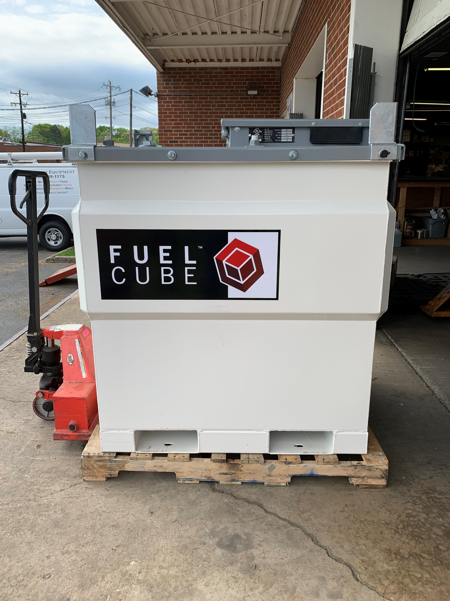
Fuel Cube
Emergency
Vents
Auto Nozzle, Inline Digital Meter, Filter Housing, Decals, Ball Valve Shutoff
Forklift Pockets
Forklift Pockets

Slide 7
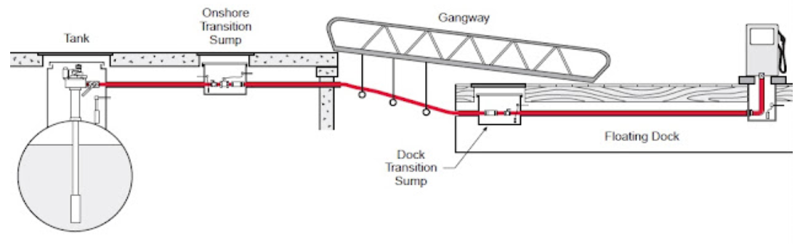
Underground Storage Tanks (UST)
Notes:
Clean up slide

Slide 8
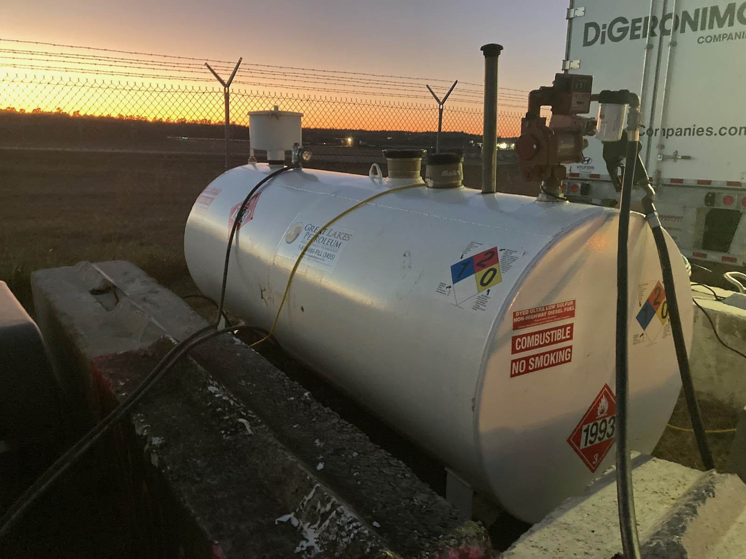
Fill
Gauge/
Monitor
T
A
N
K
O
U
T
F
I
T
E-Vent
Vent
Pump

Slide 9
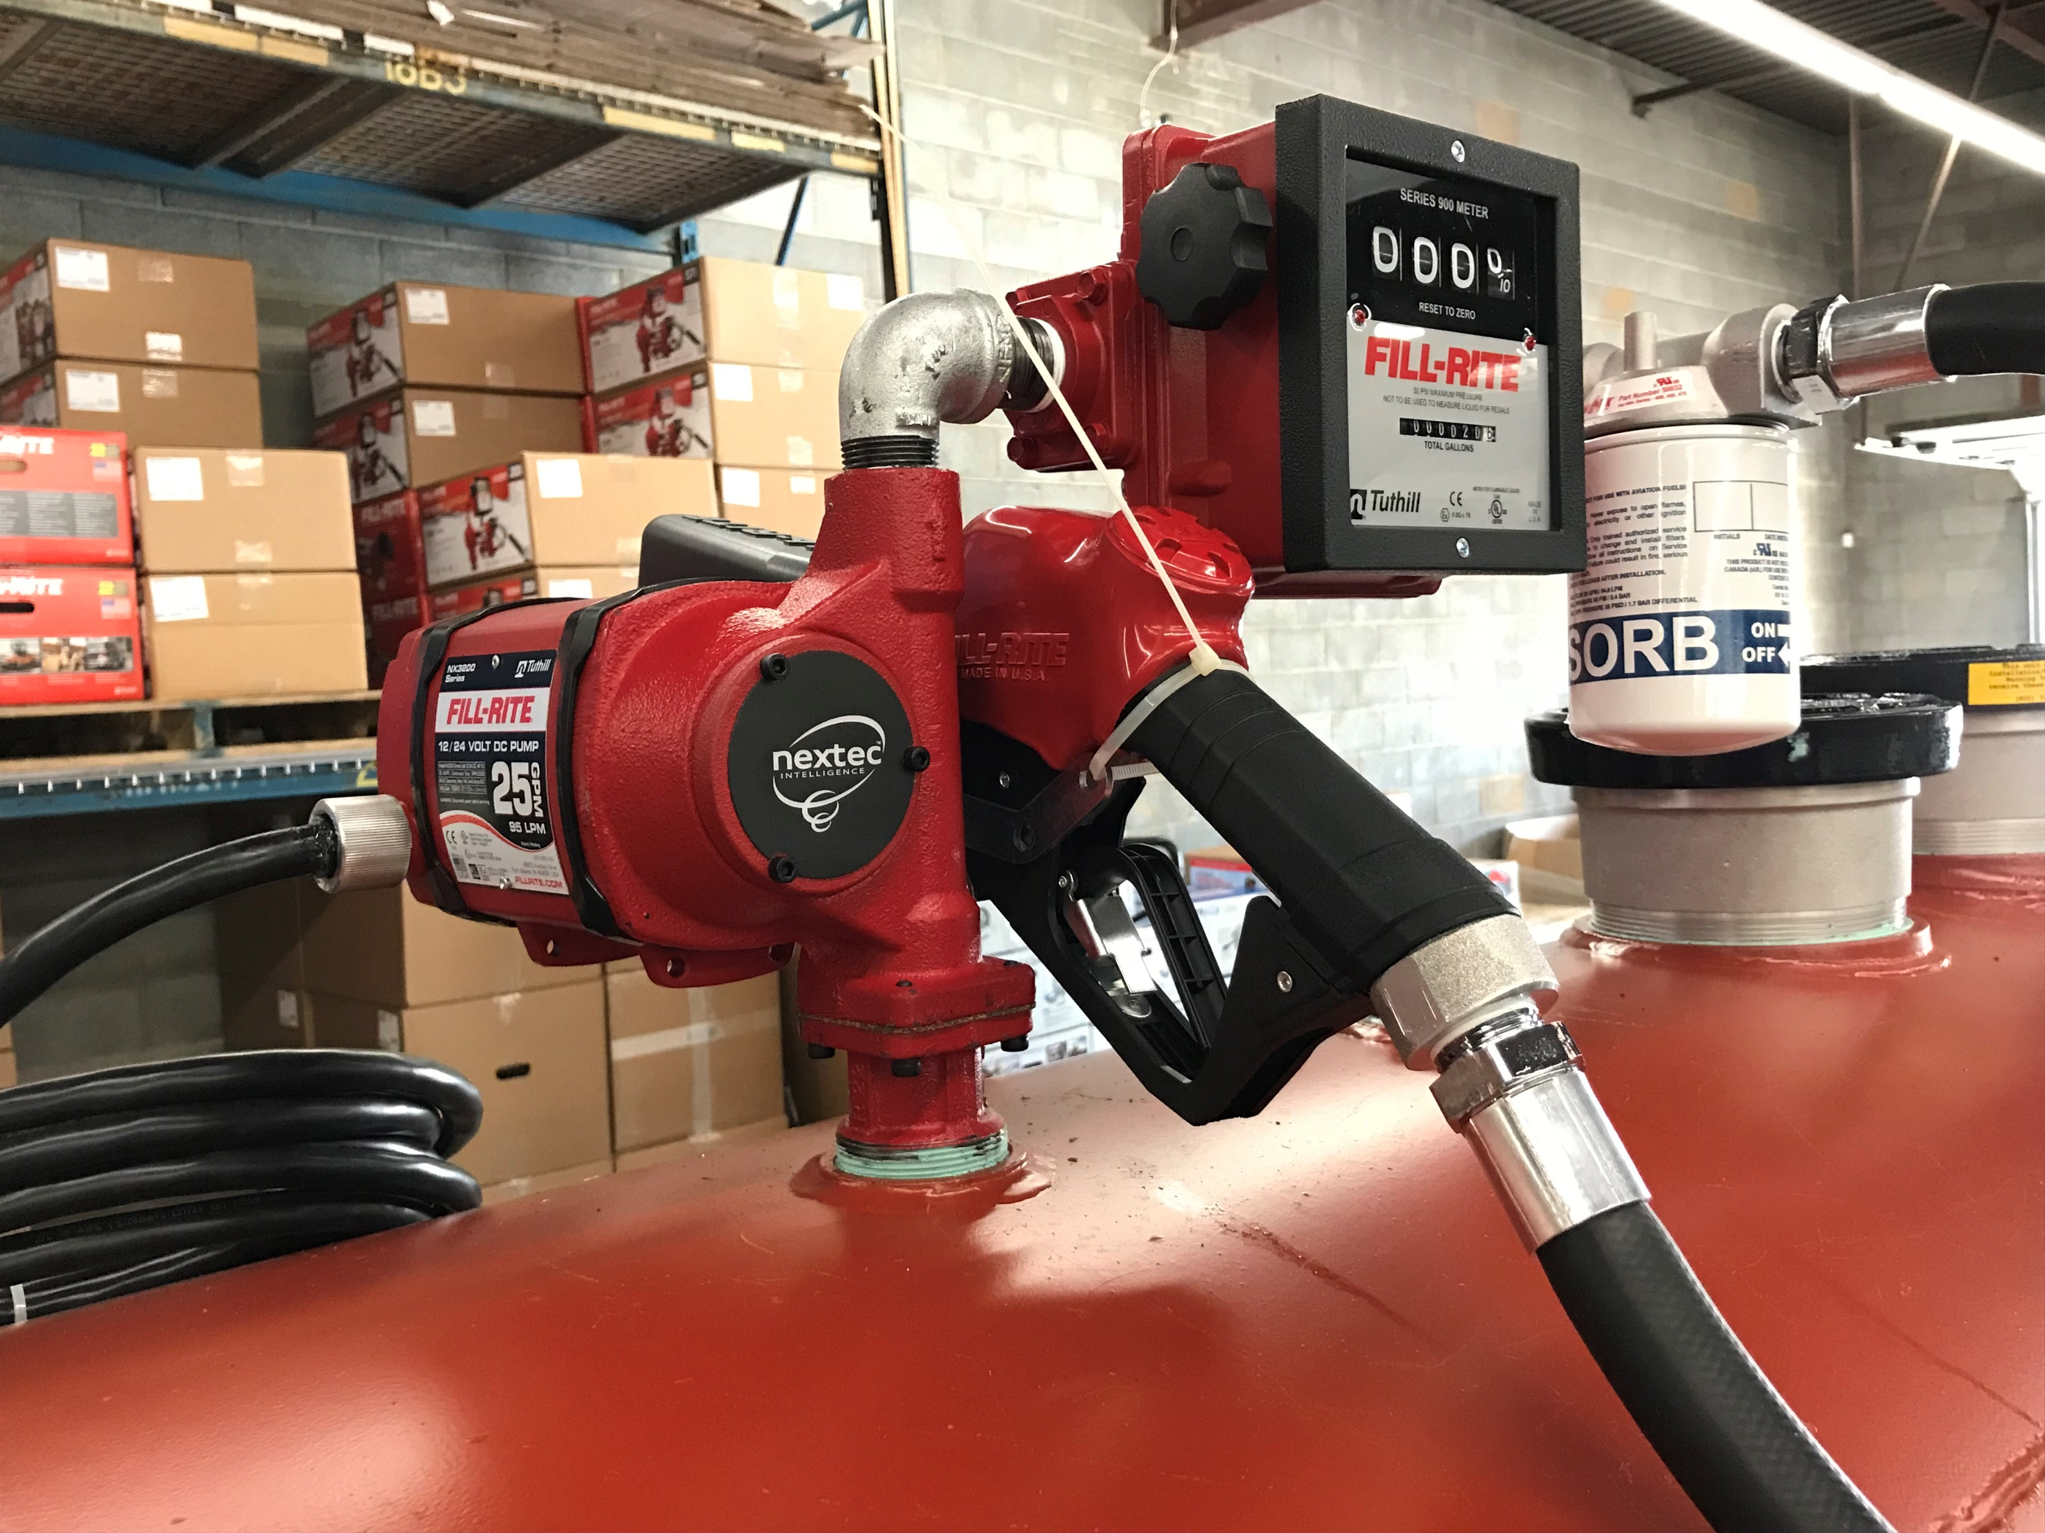
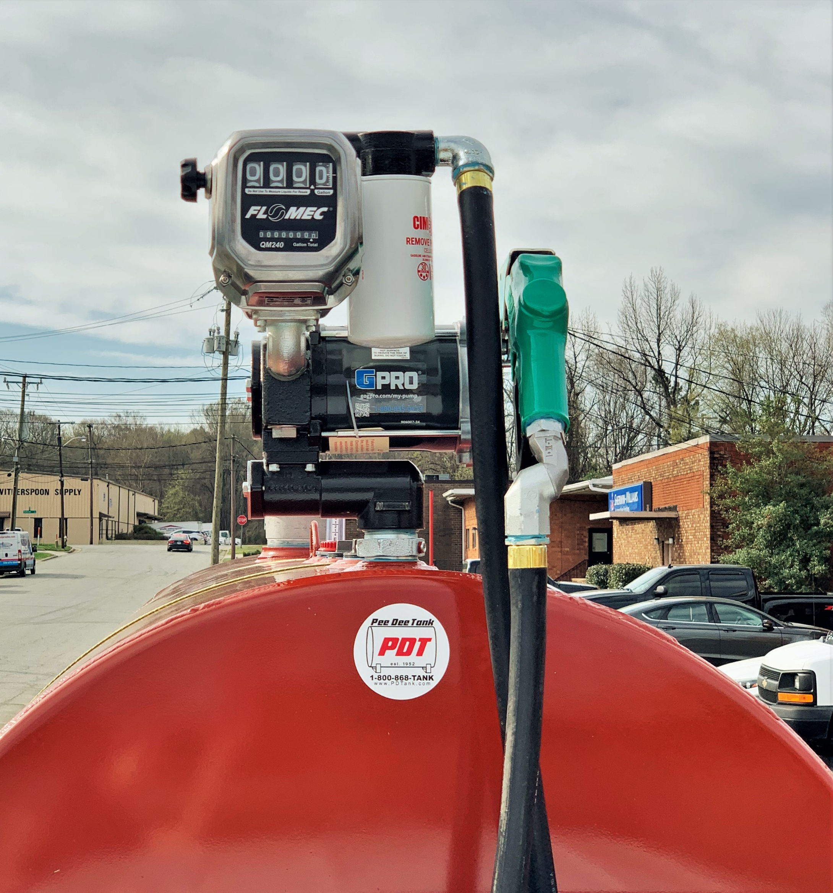
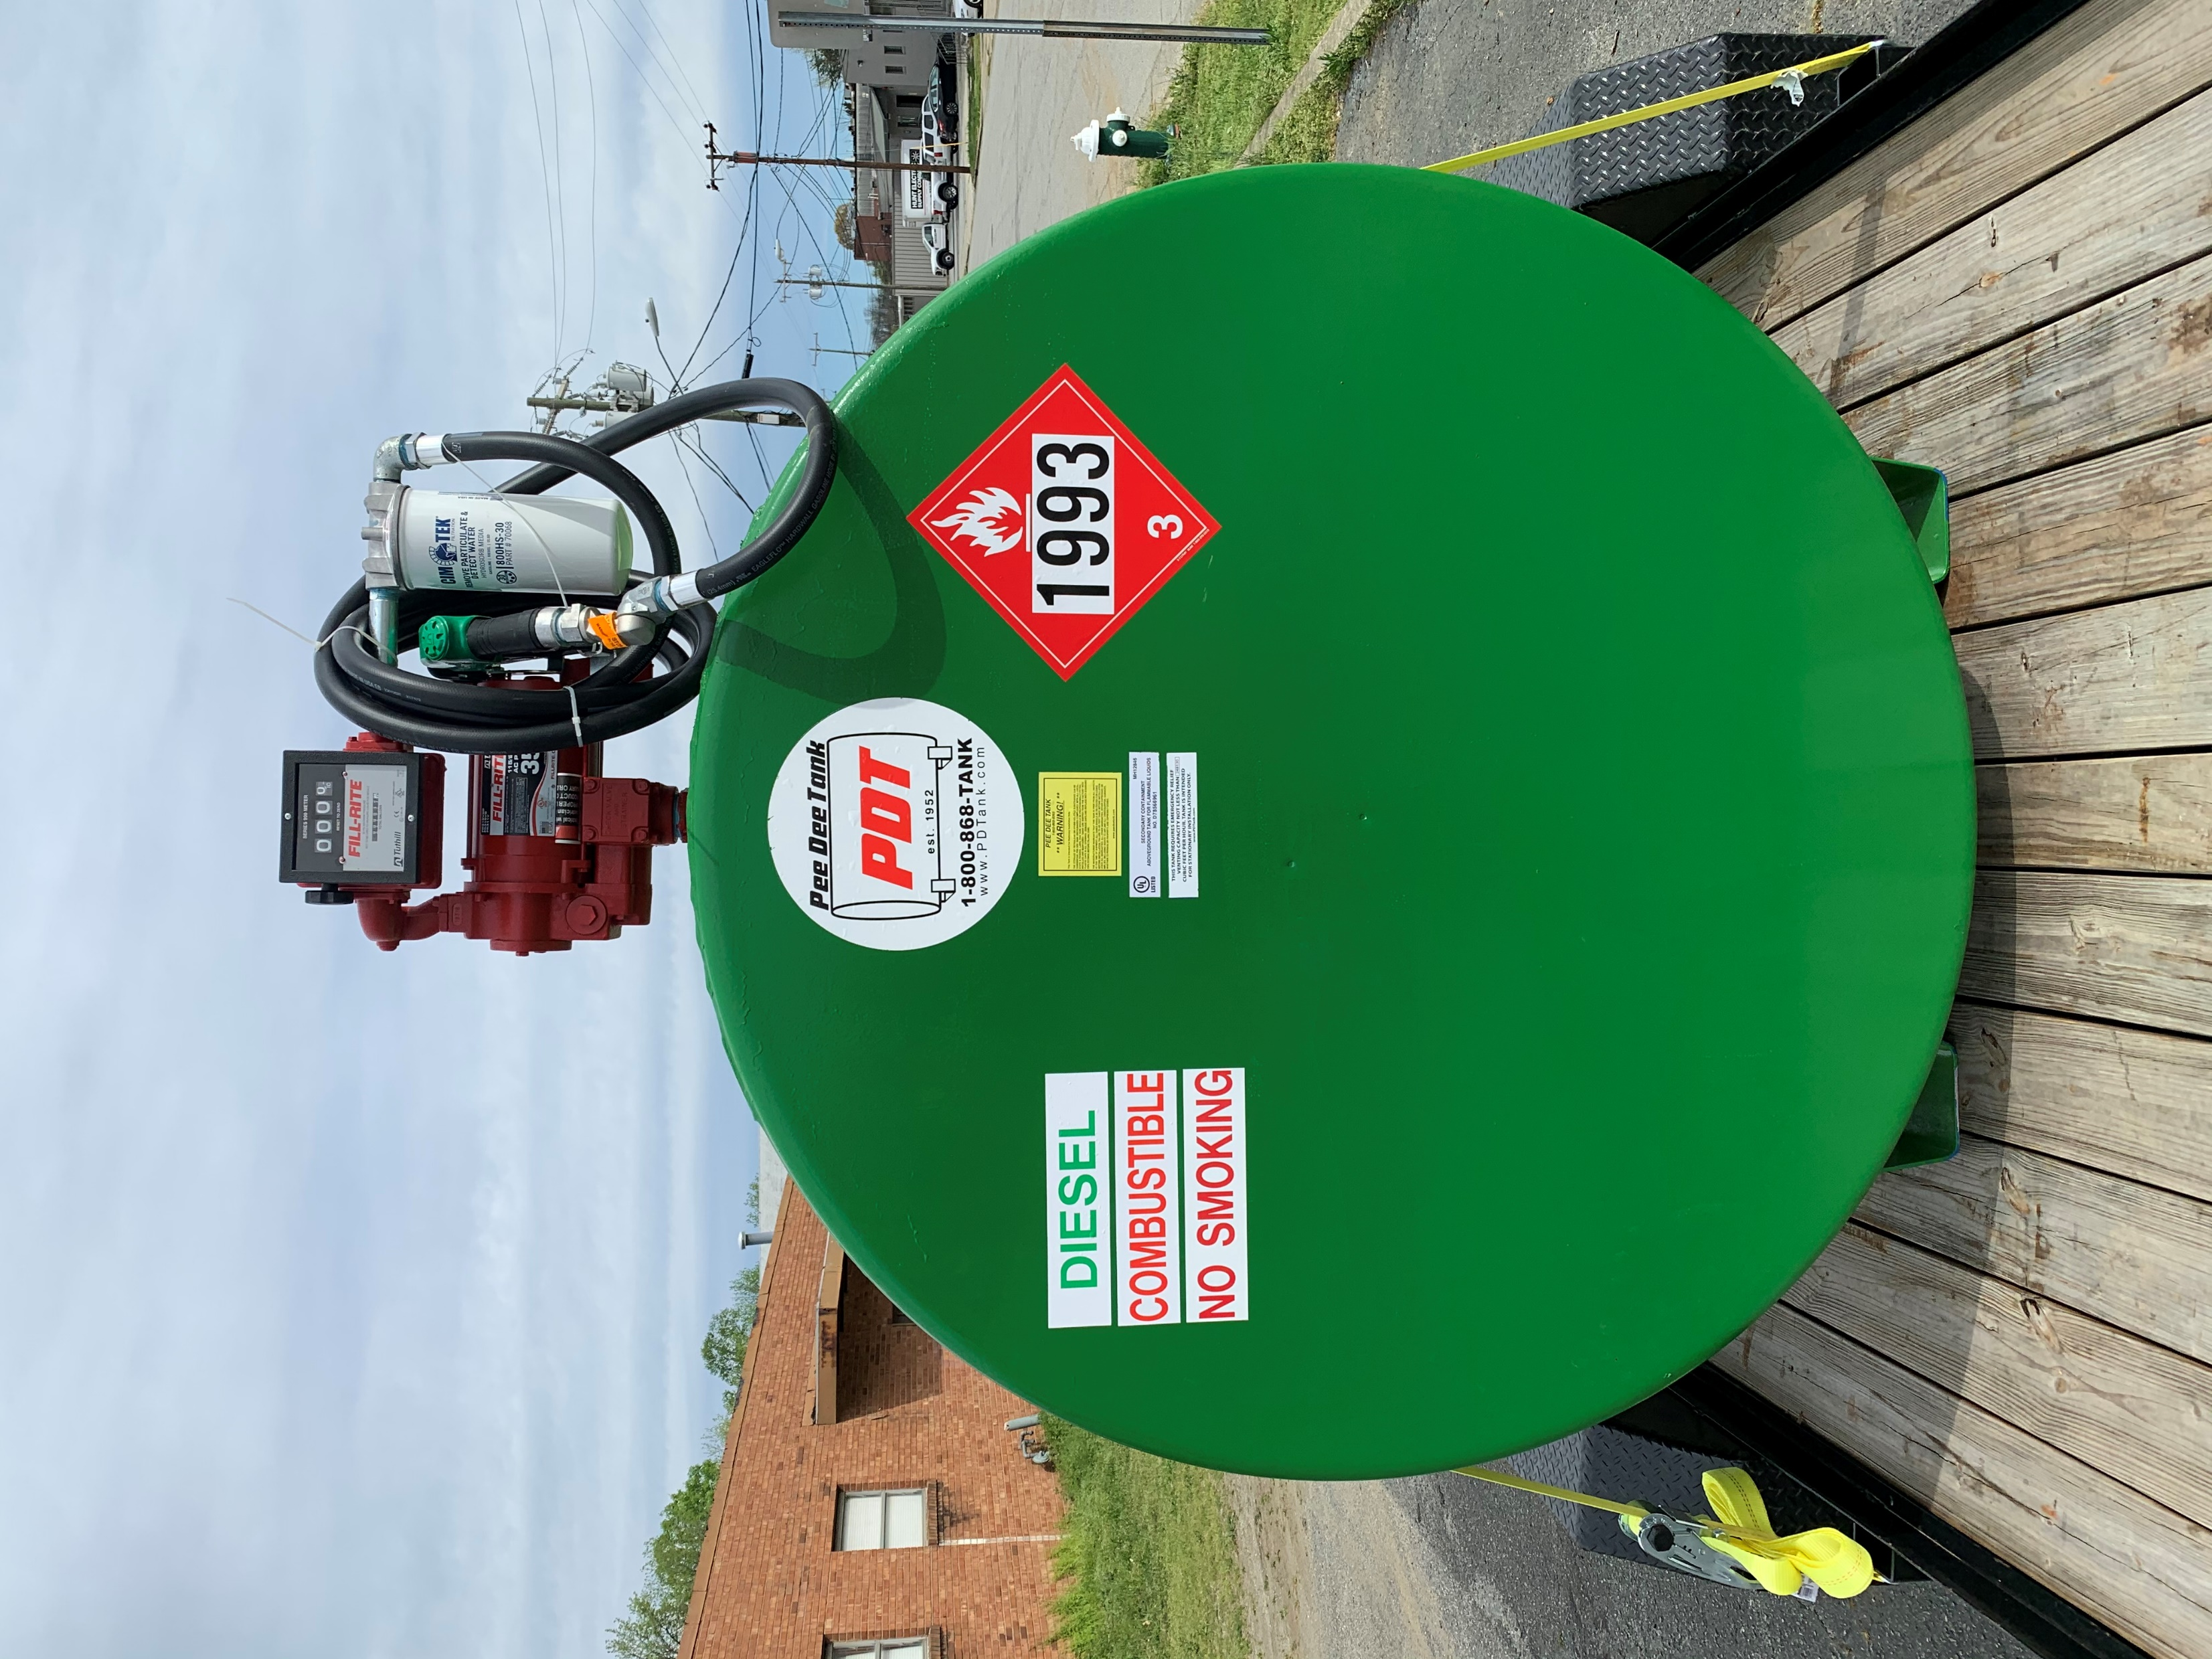
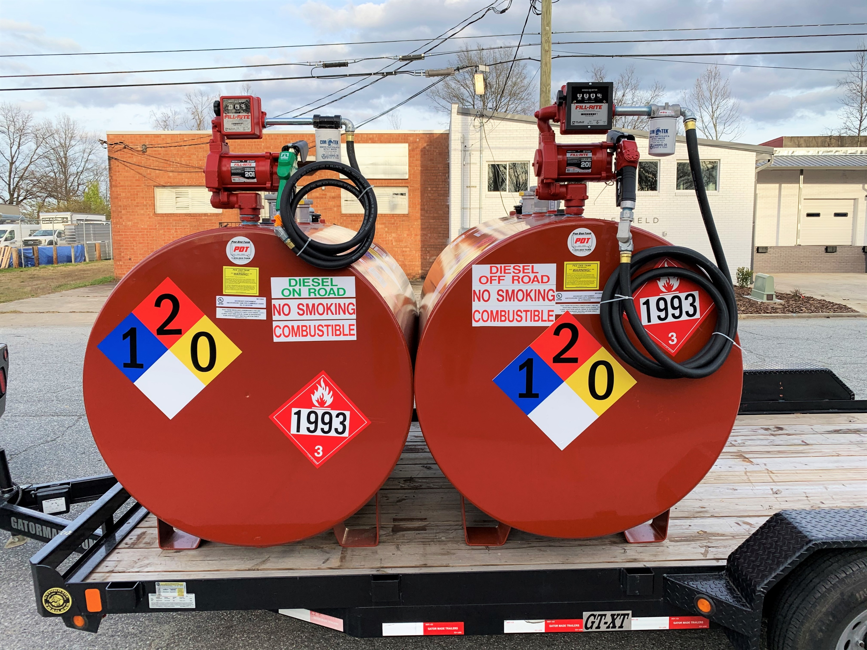
Fuel Pump Assemblies
GPRO High Speed Pump Setup
Fill-Rite High Speed Pump Setup

Slide 10


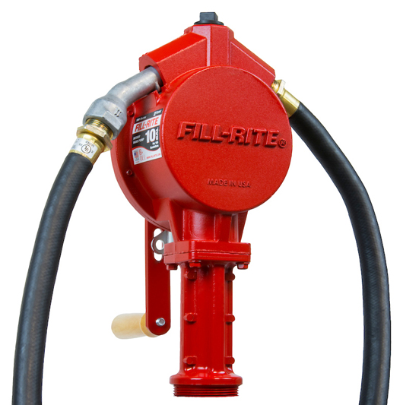
Hand Pumps
FR152
Push/Push
Manual spout
Farm hose ¾” x 8’
Telescoping suction
2” NPT bung
FR112
Rotary
2 Year Warranty
2 Year Warranty

Slide 11



Fuel Pumps - 12V
FR4204H
FR4210H
V25-012AD
Pump Only Version
2 Year Warranty
12V Pump, Auto Nozzle
1” x 18’ Hose
2 Year Warranty
12V Pump, Auto Nozzle
1” x 18’ Hose
5 Year Warranty

Slide 12



Fuel Pumps – 115 Volt
FR711VA
PRO20-115PO/QM40
PRO35-115PO/QM40
FR311VN
115V/230V Pump With 4-Wheel Mechanical Meter (Diesel Fuel)
2 Year Warranty
115V Pump, Auto Nozzle
1” x 18’ Hose, 4-Wheel Meter
2 Year Warranty
115V Pump With 4-wheel Mechanical Meter
4 Year Warranty

Slide 13

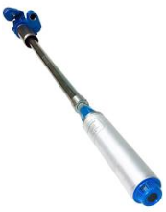
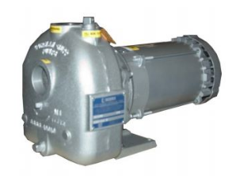
Fuel Pumps - Other
200PI6PROV
02D3-X2 1P
STP150-VL2-07
Banjo Gas powered pump w/ 6.5HP Briggs Motor
Gorman-Rupp Electric Motor Powered Pump - Self Priming
Franklin Fueling Submersible Turbine Pump

Slide 14



Mechanical Meters
QM40
+/- 0.5%
901C & 901C1.5
+/- 2%
TN860
+/- 2%
5 Year Warranty
2 Year Warranty
2 Year Warranty

Slide 15



Digital Meters
TT10AN – UL Listed
for gasoline & diesel
900CD – UL Listed for gasoline & diesel
01A31GM – UL Listed
for gasoline & diesel
* Pulse output meter available (900CDP)
2 Year Warranty
2 Year Warranty
2 Year Warranty

Slide 16



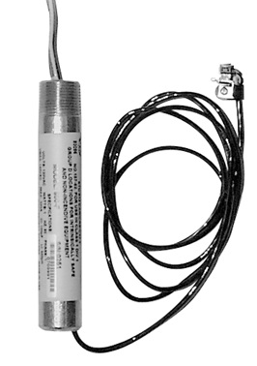


Fuel Cloud Pulsers
Standard Pulsers
Fuel Cloud
Specialty Pulsers
Western 500
1 year Warranty
PIUSI K-24
2 Year Warranty
ICS SP1
2 Year Warranty
OPW 800F
1 Year Warranty
K-24-DEF
2 Year Warranty

Slide 17


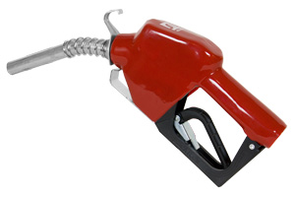
Automatic Nozzles
SDN100GAN
1” Diesel
SND075RAN
¾” Gasoline
1290-0050
1.5” High Flow
1 Year Warranty
1 Year Warranty
1 Year Warranty

Slide 18
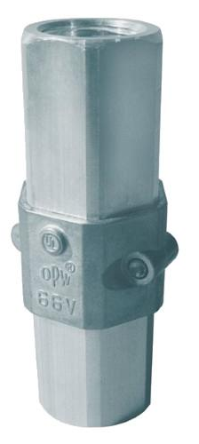

Swivels & Breakaways
Husky Swivel
0350 (¾”)
0087 (1”)
OPW Breakaway
Non-Reconnectable
66V-0300 (¾”)
66V-1300 (1”)
*Reconnectable available
1 Year Limited Warranty
1 Year Limited Warranty

Slide 19
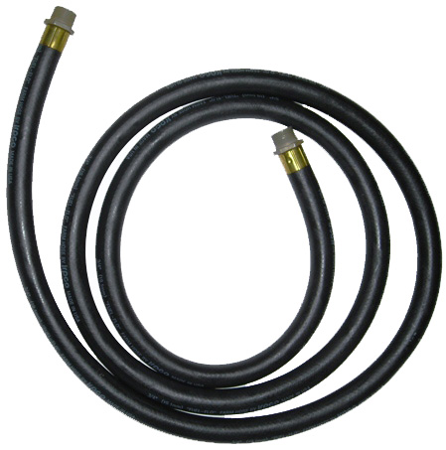

Fuel Hoses
Available in ¾” & 1”
Multiple lengths in stock
FPH-B-3/4X12
(Farm)
EFHW-1X20
(Hard wall)
1 Year Limited Warranty
1 Year Limited Warranty

Slide 20


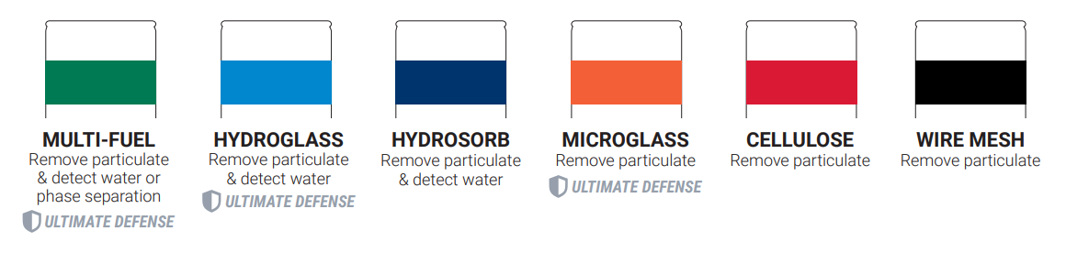
Filters

Slide 21



PetroClear Ships From Factory - Not Stocked Due To Higher Expense But Available Upon Request
(Lead Time To Apply)

Slide 22
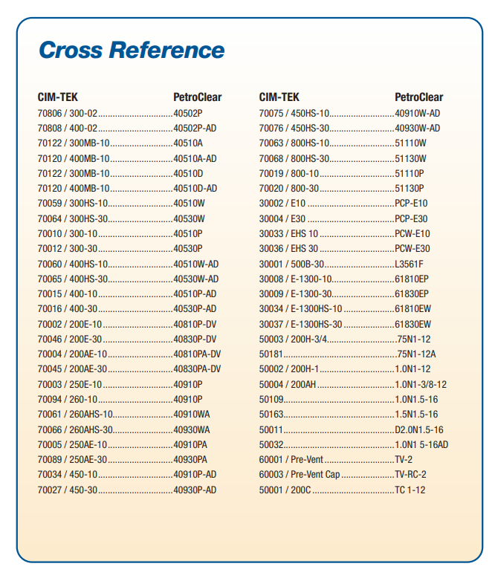





Slide 23
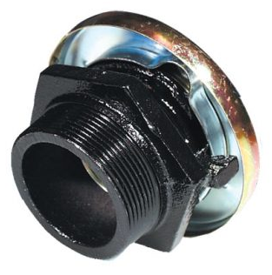

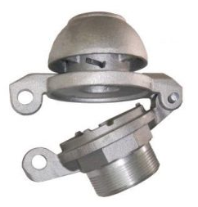

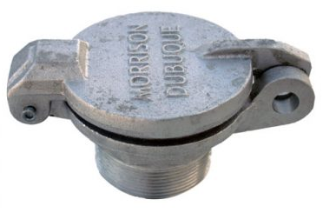
Tank Fill Caps
Pressure Vent/Fill Cap
Fill Cap – Cast Iron
Fill Cap + Open Air Vent Combo
Tight Seal Fill Cap
Fill Cap – Aluminum

Slide 24
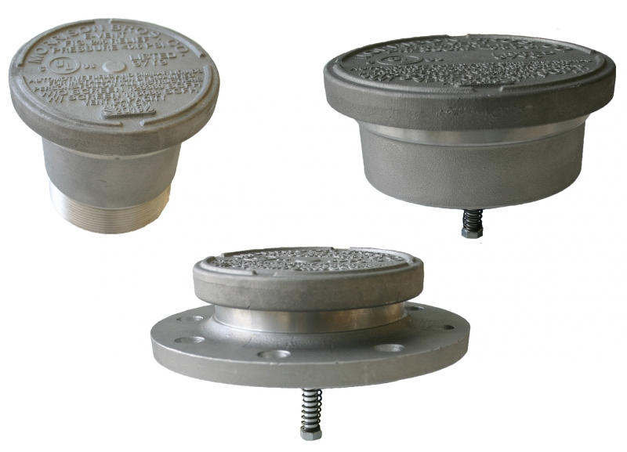
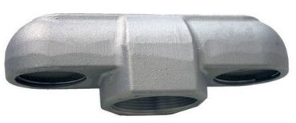
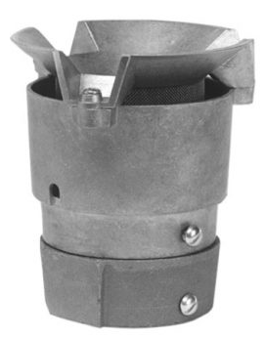
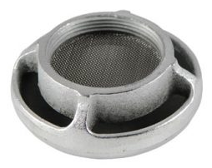

Tank Ventilation
Emergency Vents
Pressure/Vacuum Vents
Open Air Vents

Slide 25
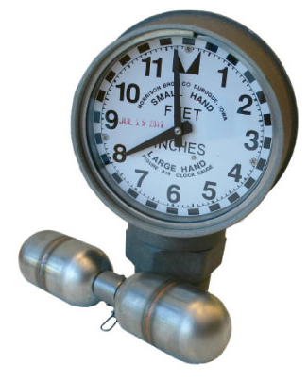
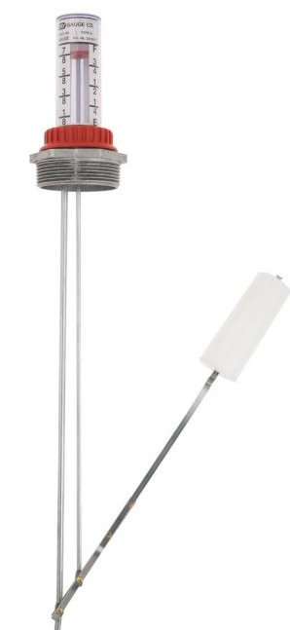
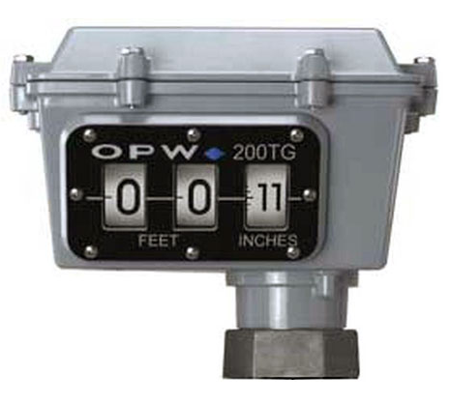
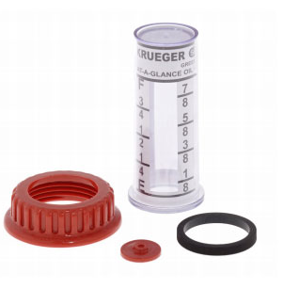
Tank Gauging
Swing Arm Gauge
200TG Mechanical
818 Clock Gauge
1 Year Warranty
1 Year Limited Warranty
1 Year Limited Warranty
Notes:
Fix layout

Slide 26



Tank Gauging Alarms
Sight Gauge w/ Audible Alarm
918 Clock Gauge w/ Alarm
High/Low Level Alarm
1 Year Limited Warranty
1 Year Warranty
1 Year Limited Warranty
Notes:
Check centering

Slide 27

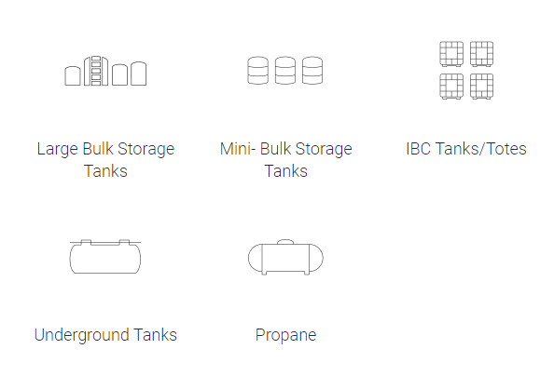
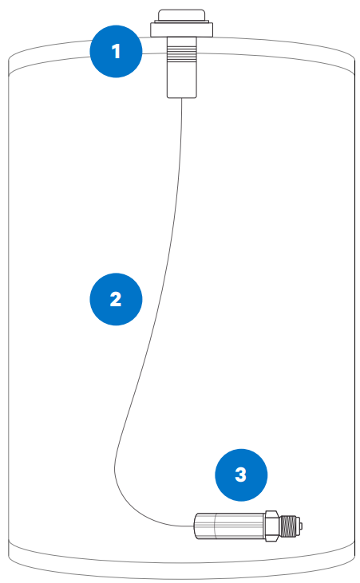
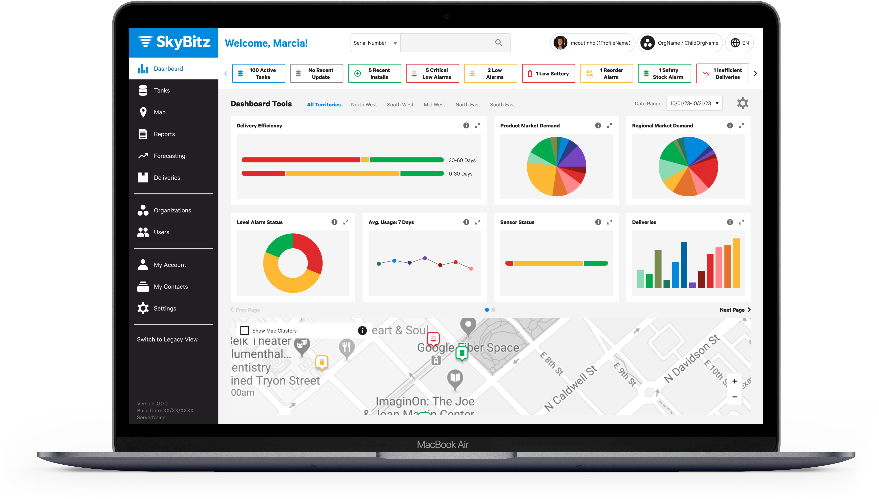
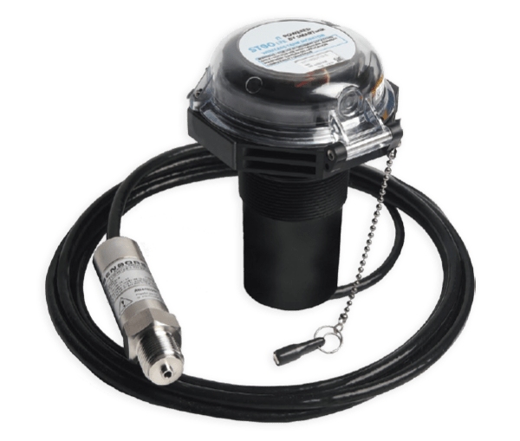
Monitors

Slide 28
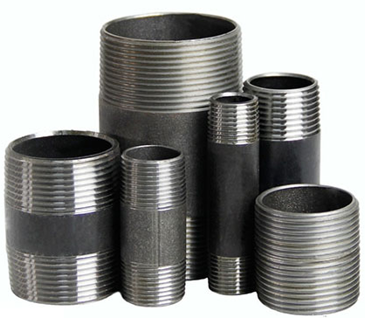
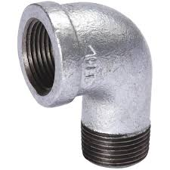
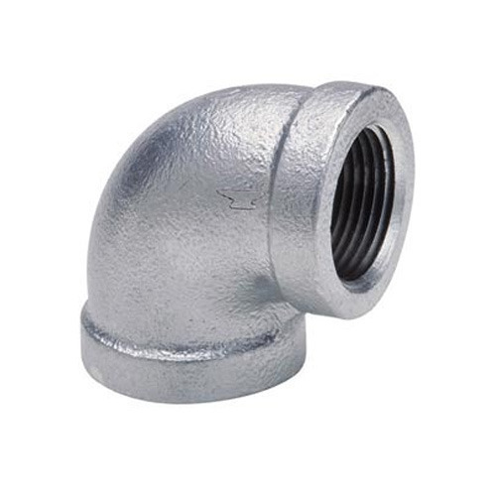
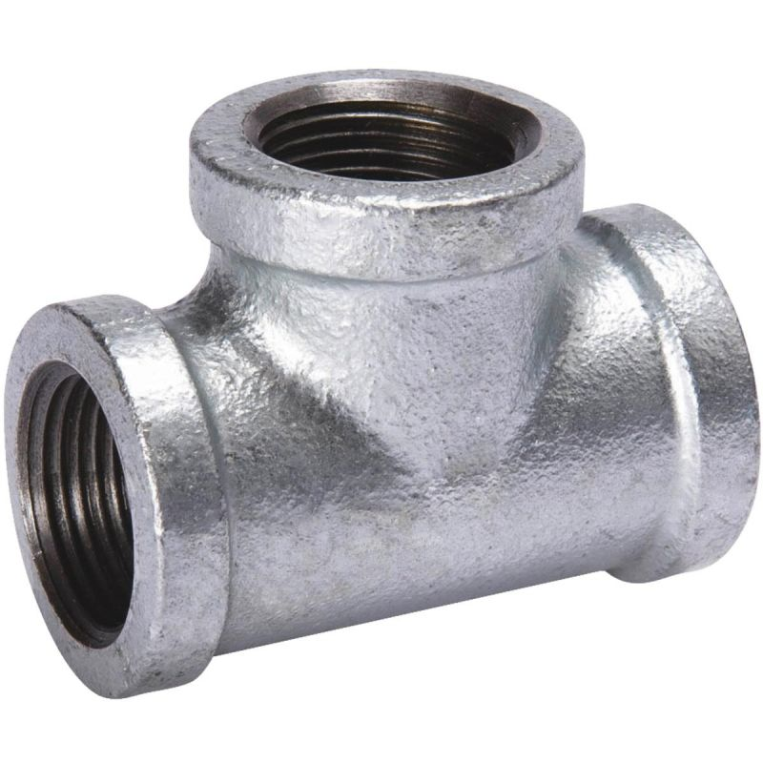
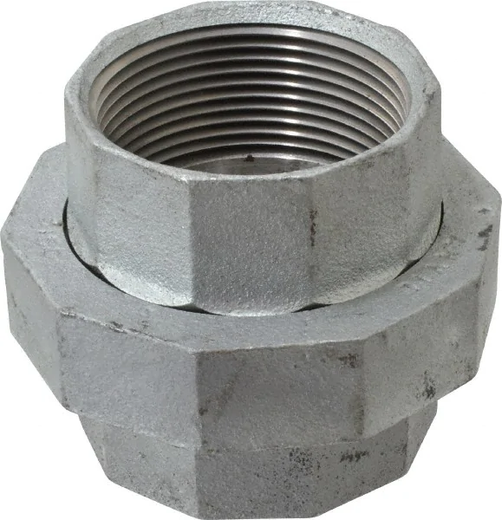

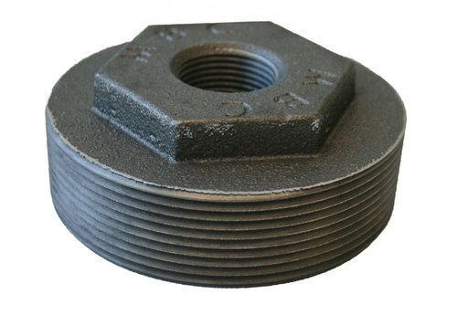
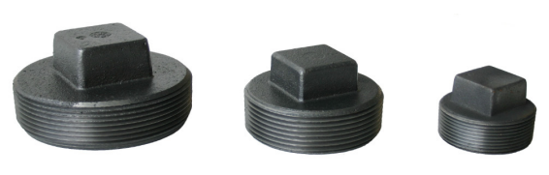
Pipe Fittings
Couplers
Double Tapped Bushings
Elbows
Pipe Nipples
Plugs
Reducer
Bushings
Street Elbows
Tees
Unions
Notes:
Fix layout/balance

Slide 29


Hannay Reels
HAND CRANK
SPRING REWIND
ELECTRIC DRIVEN w/ MOTOR
3 Year Limited Warranty

Slide 30





High Hose Retriever
Maximum 10.5ft when using the supplied base. This can be extended if pipe is braced along its vertical travel.

Slide 31


Fuel Tank Manifold Kits
Tank Manifold Kit:
Comes with all necessary & pre-installed components to tether 2) 500-gallon fuel tanks together

Slide 32



Remote Fill Applications
Morrison 715 Series Remote Fill Box
9095SA Overfill
Prevention Valve
918 Clock Gauge w/Alarm
Notes:
Fix layout

Slide 33


Gas Powered Engine Tank Outfits

Slide 34




Custom Solar Panel Tank
1000-gallon double wall
Heavy duty pipe skids
Lockable battery box
12V batteries
Power cables
100-watt Solar Panel
Pump/Meter combo
Auto nozzle

Slide 35





DEF Equipment
55-gallon Drum
Portable Pod
(58-gal or 116-gal)
Totes
(270-gal or 330-gal
Bulk Storage
No matter the size – We have DEF equipment solutions for you

Slide 36


DEF Pumps
12V or 120V
Inline Filter
Auto nozzle w/ built-in digital meter
20ft discharge hose
6.5ft suction hose to PDC valve
Tote hanger
Electric Pumps
Hand Pumps
Up to 10 Gal. per 100 revolutions
IBC mount bracket
3.2ft suction hose
9ft discharge hose

Slide 37


DEF Tote Suction Kits
TOTE-SUCTION-KIT: dual bung tote caps, RSV container valve, suction tube, 2” poly buttress plug
TOTE-MANIFOLD-KIT: dual bung tote caps, poly RPV female valves, PDC 4-pin connectors, 2” poly buttress plugs, 90° hose barbs ¾”, 9ft hose cut to 3ft each, ¾ hose barb tee to join hoses, hose clamps, suction tubes

Slide 38









DEF Components
Poly Dual bung IBC Tote Cap for dispensing & filling
Bulkhead Fitting
RSV Dispense Coupler SS
PDC – Piusi DEF Coupler
RSV Container Valve SS
Poly Cam & Groove
Poly Fittings
Poly Reducer Fitting

Slide 39






DEF Dispensing
Nozzles – Manual, Auto, Auto w/ Meter
Inline Digital Meters
DEF Filtration
DEF Compatible Reels

Slide 40




Oil / Lube Equipment

Slide 41







Lube Equipment Dispensing
Oil Pumps
1:1, 3:1, & 5:1
Reels
Compatible with Air,
Water and Oil
Control Handles
Mechanical & Digital
Non-Preset & Preset
Accessories
Air Regulators
Swivels/Reducers
Discharge Hoses
Dollies/Carts

Slide 42




Tank Delivery

Slide 43




Bulk Plant Repairs

Slide 44




Fabrication

Slide 45






Safety & Environmental
Spill Kit
Absorbent Pads
Dike
Oil Dry
Berm

Slide 46


Gloves
Predator Nitrile
Black Nitrile Disposable
Available in size Small – XL
Rough or Smooth grip
Sold in dozens
Jersey Lined
Available in size Small – 2XL
100 ct box
Powder free

Slide 47








Fuel Additives

Slide 48


T
R
O
U
B
L
E
S
H
O
O
T
I
N
G

Slide 49



Slide 50

Notes:
I need to make sure to reiterate to them, that they can resale or pass their customer to us for specialty or additional equipment that they are responsible for and want the customer to pay for.

Slide 51

Additional Information and Resources

Slide 52

Thank You!
We Really Appreciate Your Business!
Notes:
I can say any questions here

